Slide 1
PRESENTATION ON INTERIOR DESIGNING PROJECT

Slide 2
INTERIOR DESIGNING

Slide 3
WHAT IS INTERIOR DESIGNING
INTERIOR DESIGNING IS THE PROCESS OF IMPROVISING THE DEGREE OF EXCELLENCE OF SOMETHING IN INTERIOR AS WELL AS INCLUDING THE EXTERIORS OF THE GIVEN SPACE OR GIVEN BUILDINGS.
IT’S THE PROCESS OF SHAPING THE KNOWLEDGE OF INTERIOR SPACE ,THROUGH UNSCRUPULOUS WAY OF SPACE PROVIDEDAND SURFACE TREATMENT FOR THE BETTERMENT OF OUR LIVING.

Slide 4
WHY IS AN EXPERT FOR INTERIOR DESIGNING NEEDED?
AS WE KNOW,THAT DESIGNING OF THE INTERIOR IS THE PROCESS OF IMPROVISING THE DEGREE OF EXCELENCE OF INTERIORS BYUDERSTANDING THE NAME OF THE CLIENTS.S IT IS VERY IMPORTANT TO SELECT A PROFFESSIONAL AND A FAMOUS INTERIOR DESIGNER, WHO REALLY KNOWS WHAT HE IS DOING.

Slide 5
OFFICE INTERIOR DESIGNS
IN TODAY’S WORLD PEOPLE WANT THEIR WORKSPACE TO LOOK LIKE A BUISSINESS CONFERENCE ROOM.
THEY WANT THEIR OFFICE TO BE THE BEST WORLD CLASS WORKSPACE.

Slide 6
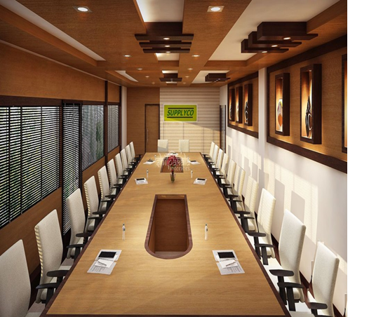

OFFICE INTERIOR DESIGNS

Slide 7
HOME INTERIOR DESIGNS
EVERYONE WANTS THEIR HOUSE TO BE DECORATED WITH CREATIVE IDAS AND GET A GREAT REALXIG AND SMOOTHING ENVIRONMENT.
PEOPLE WANT THEIR HOUSE TO LOOK LUXURIOUS BY ADDING EXOENSIVE ELEMENTS ON THE WALLS AND CARPETS ON THE FLOORS.

Slide 8
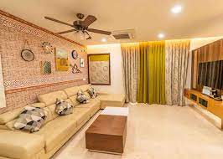
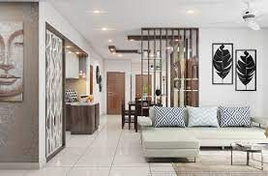
HOME INTERIOR DESIGNS

Slide 9
BUILDING INTERIOR DESIGNS
IN TODAY’S WORLD EVERYONE WANTS A GOOD DESIGN BUILDING AND SPACE TO LIVE IN.
THEY WANT THE DESIGN OF THE BUILDING TO LOOK VIBRANT AND EYECATCHING SO THAT IT HEPS BY ATTRACTING PEOPLE.

Slide 10
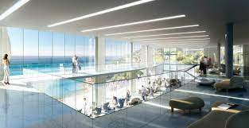
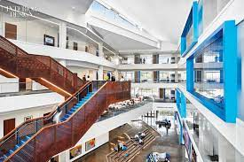
BUILDING INTERIOR DESIGNS

Slide 11
BEDROOM INTERIOR DESIGN
BEDROOM DESIGNING SHOULD BE DONE WITH ALMOST CARE AND IT SHOULD BE IN SUCH A WAY THAT GIVES YOU A SPACE WHERE YOU CAN FORGET YOUR STRESS AND RELAX
BEDROOM IS A PLCE WHERE YOU ARE FREE TO DO WHATEVER YOU WANT SO IT SHOULD BE DONE WITH REFERENCE FORM THE CLIENT.

Slide 12
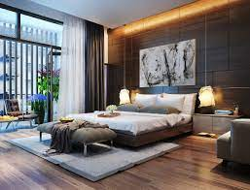
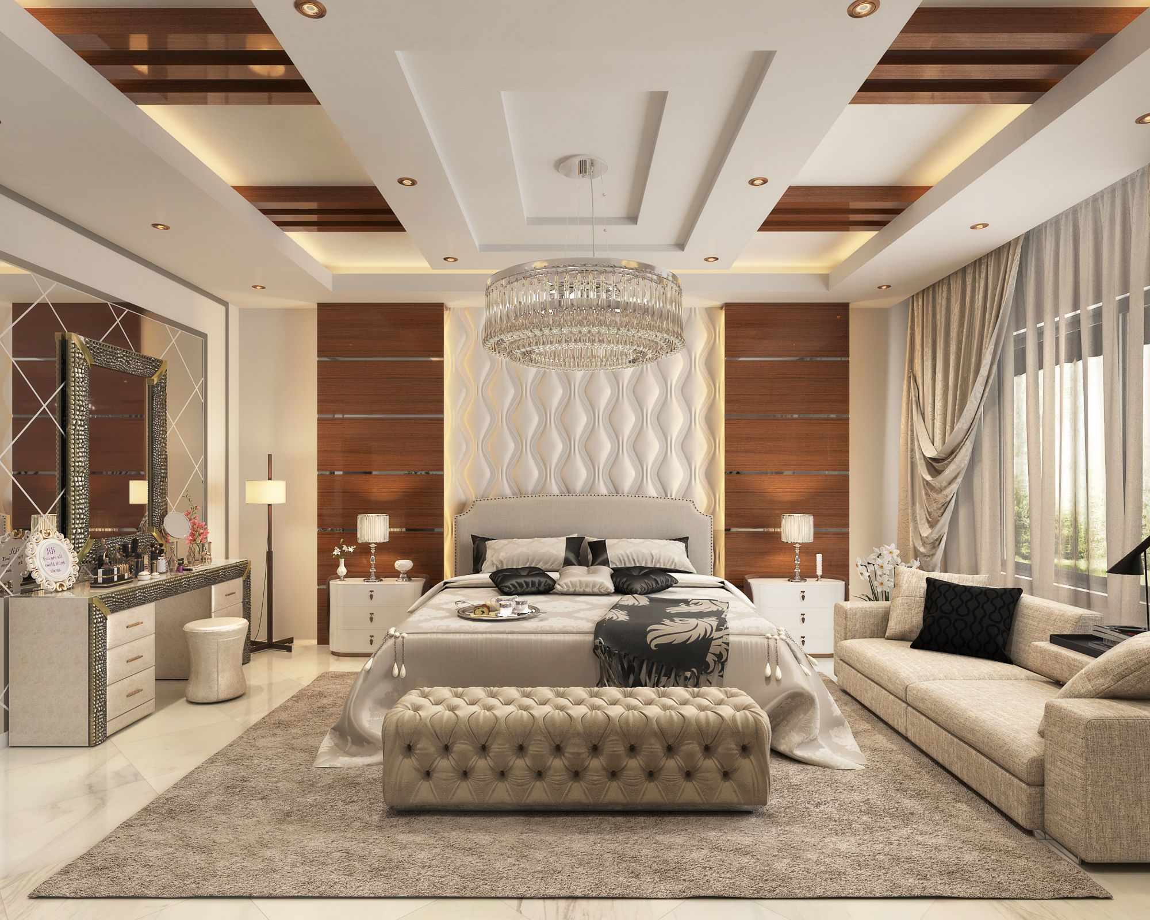
BEDROOM INTERIOR DESIGN

Slide 13
CARS INTERIOR DESIGN
IN TODAY’S TIME CAR IS A NECESSITY FOR THE PEOPLE.
CARS ARE OFTEN CONSIDERED AS HOME AWAY FROM HOME.
INTERIOR OF THE CAR TO LOOKIS THE FIRST PRIORITY OF THE COMPANY.

Slide 14
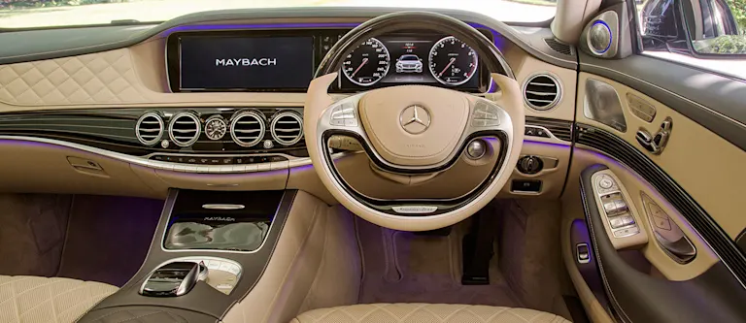
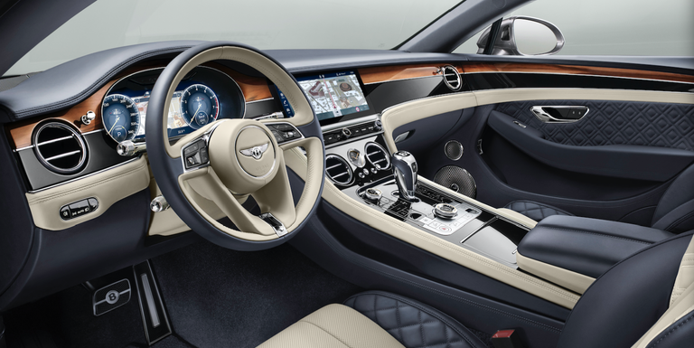
CARS INTERIOR DESIGN

Slide 15
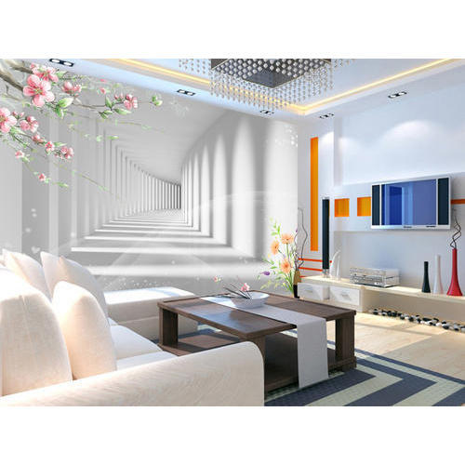
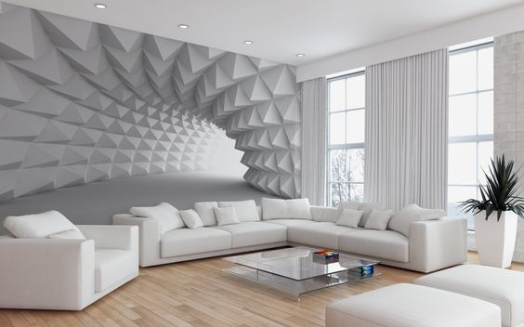
3D INTERIOR HOME DESIGNS

Slide 16
WHY US
OUR MAIN MOTTO IS OUR CLIENTS FULL SATISFACTION AND OUR PEOPLE THRIVE WITH FULL DEDICATION AND HARDWORK TO SATISFY OUR CLIENTS.
DUE TO WHICH WE HAVE 100% SATISFACTORY RATE FROM THE RESULTS FROM OUR CLIENTS.
WE RE THE ONE OF THE BEST INTERIOR DESIGNING COMPANY IN THE TOWN.

Slide 17
CONCLUSION
INTERIOR DESIGN IS A SCIENCE AS WELL AS AN ART OF UNDERSTANDING CLIENTS BEHAVIOUR TO CREATE FUNCTIONAL SPACES WITHIN A BUILDING.
DECORATION IS AN ART OF FURNISHING OR ADORNING OF A SPACE WITH FASHIONABLE AND BEAUTIFUL ITEMS .
TO CUT SHORT THE DEFINITION,”INTERIOR DESIGNING MAY DECORATE ,BUT DECORATORS DO NOT DESIGN.

Slide 18
THANK YOU

Slide 19
PROJECT BY:- SAAD SHAIKH
PPT & REPORT BY:-MANAN SUTHAR
GUIDED BY :- YASH SUTHAR
SUBMITTED TO:-
PARUL POLYTECHNIC INSTITUTE (PPI)

